Slide 1
Lecture 5:
Backpropagation
and
Neural Networks part 1

Slide 2
Another help session this Friday
On vector and matrix derivatives and backprop.

Slide 3
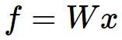

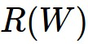
Computational Graph
x
*
s (scores)
hinge loss
+
L
W
R

Slide 4
Overview of where we’re going
We want to evaluate the gradient of a Loss function L(x,W,...), with respect to the parameters (weights) of a neural network, at the “point” represented by the arguments to the function (x,W,...).
We are not interested in an algebraic expression for the gradient, but rather only in the evaluation of that gradient at the current value of the function arguments.

Slide 5
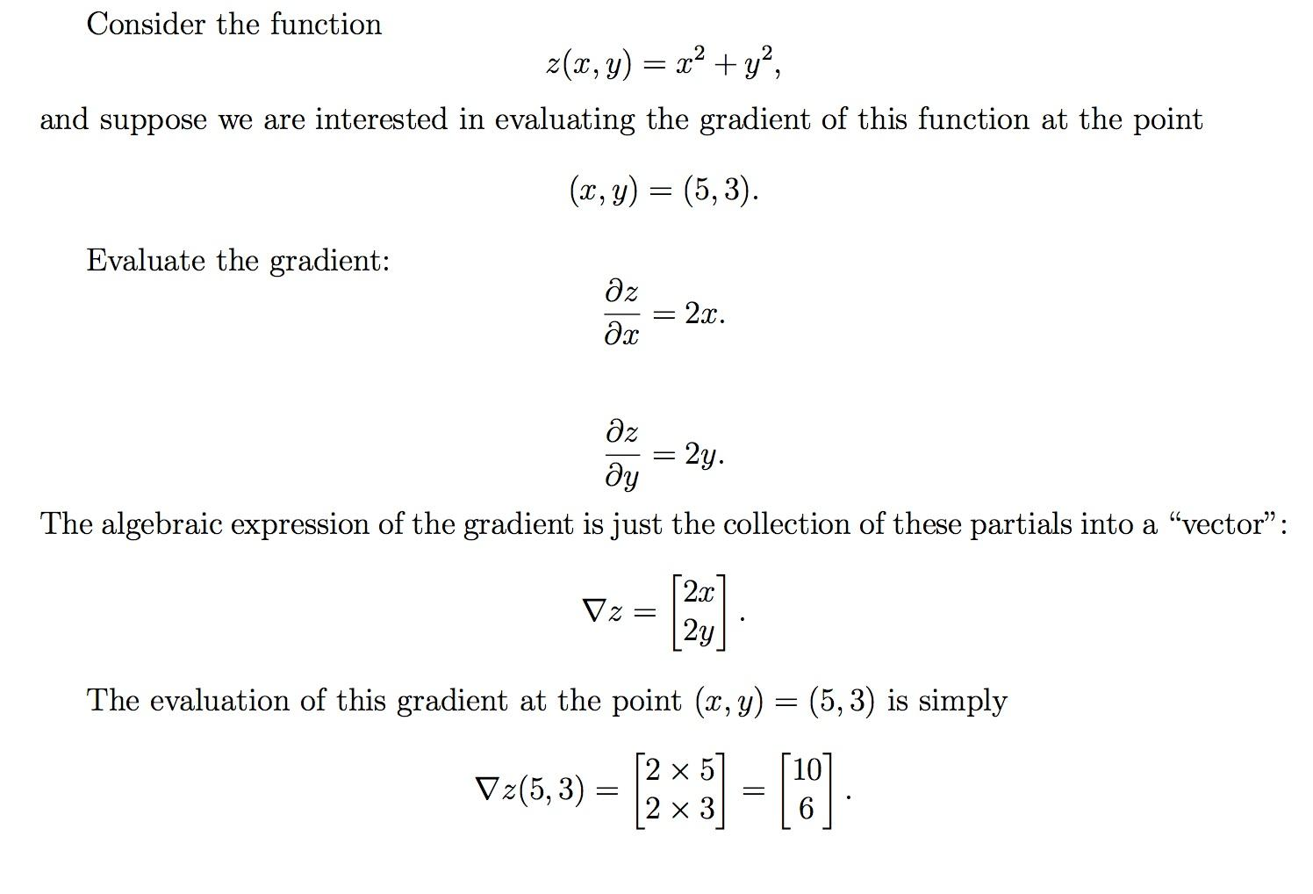
Don’t care about this
Do care about this

Slide 6
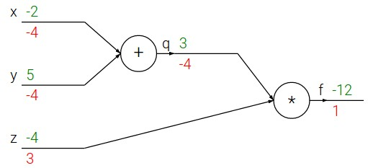
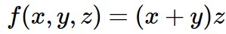
e.g. x = -2, y = 5, z = -4

Slide 7
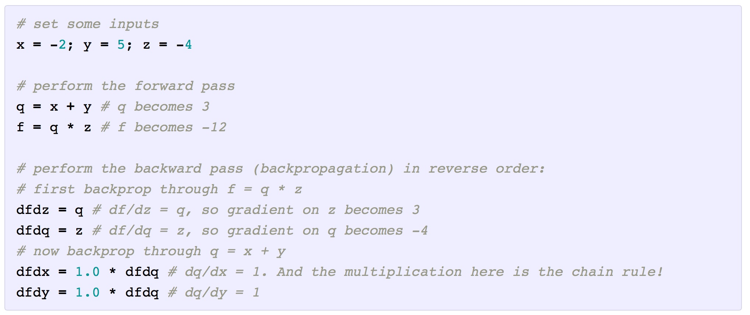
Forward pass in python

Slide 8
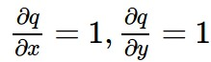
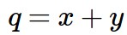
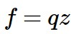
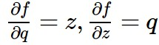
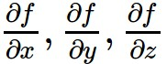
e.g. x = -2, y = 5, z = -4
Want:

Slide 9
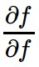
e.g. x = -2, y = 5, z = -4
Want:

Slide 10
e.g. x = -2, y = 5, z = -4
Want:

Slide 11
e.g. x = -2, y = 5, z = -4
Want:

Slide 12
e.g. x = -2, y = 5, z = -4
Want:

Slide 13
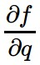
e.g. x = -2, y = 5, z = -4
Want:

Slide 14
e.g. x = -2, y = 5, z = -4
Want:

Slide 15
e.g. x = -2, y = 5, z = -4
Want:

Slide 16
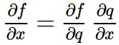
e.g. x = -2, y = 5, z = -4
Chain rule:
Want:

Slide 17
e.g. x = -2, y = 5, z = -4
Want:

Slide 18
e.g. x = -2, y = 5, z = -4
Chain rule:
Want:

Slide 19
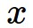
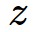
activations
f

Slide 20
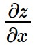
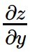
activations
f
“local gradient”

Slide 21
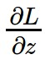
activations
f
“local gradient”
gradients

Slide 22
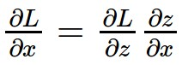
activations
f
“local gradient”
gradients

Slide 23
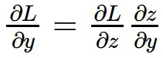
activations
f
“local gradient”
gradients

Slide 24
activations
f
“local gradient”
gradients

Slide 25
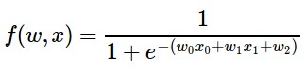
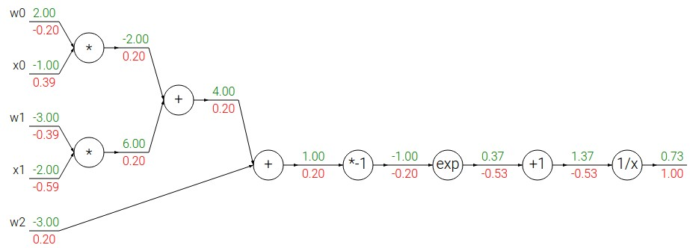
Another example:

Slide 26
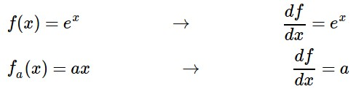
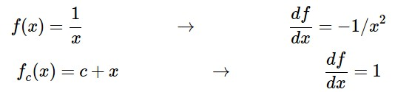
Another example:

Slide 27
Another example:

Slide 28
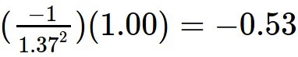
Another example:

Slide 29
Another example:

Slide 30
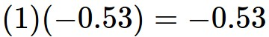
Another example:

Slide 31
Another example:

Slide 32
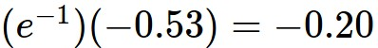
Another example:

Slide 33
Another example:

Slide 34
Another example:
(-1) * (-0.20) = 0.20

Slide 35
Another example:

Slide 36
Another example:
[local gradient] x [its gradient]
[1] x [0.2] = 0.2
[1] x [0.2] = 0.2 (both inputs!)

Slide 37
Another example:

Slide 38
Another example:
[local gradient] x [its gradient]
x0: [2] x [0.2] = 0.4
w0: [-1] x [0.2] = -0.2

Slide 39
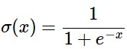
sigmoid function
sigmoid gate

Slide 40
sigmoid function
sigmoid gate
(0.73) * (1 - 0.73) = 0.2

Slide 41
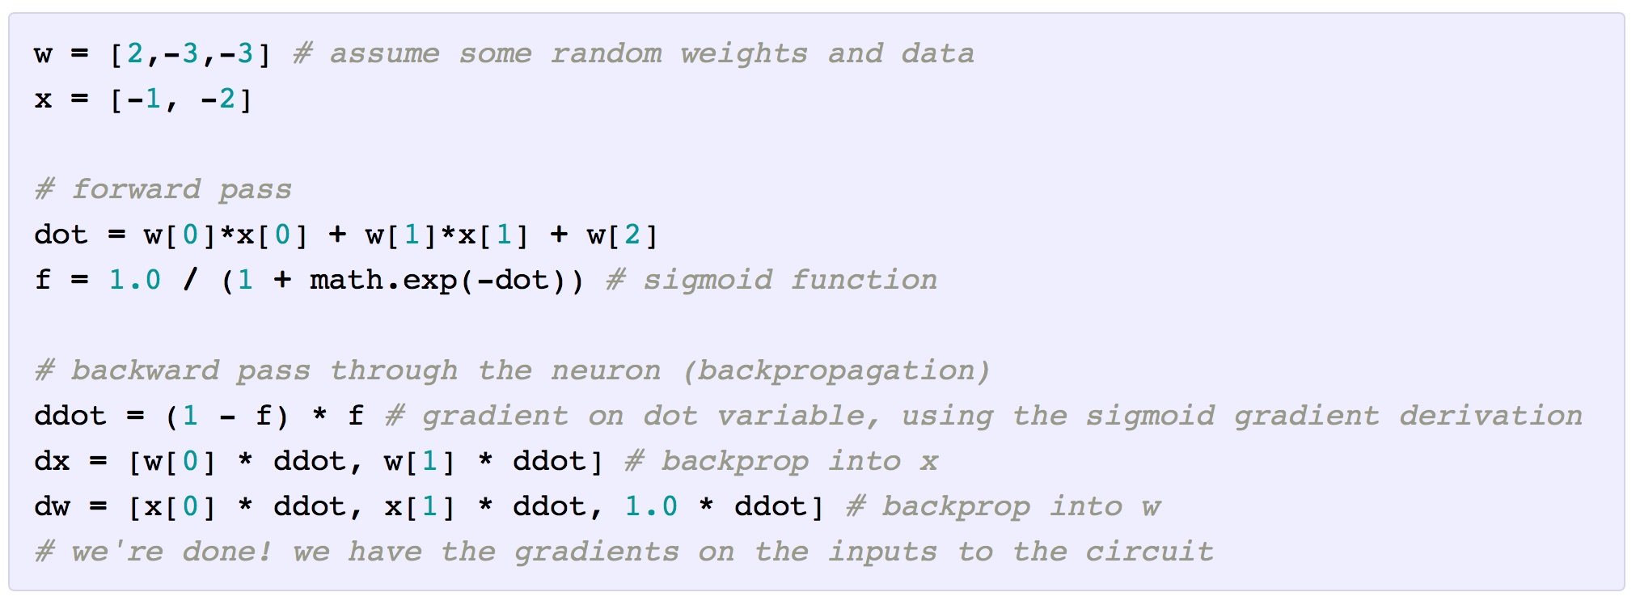
Forward and backwards passes in Python

Slide 42
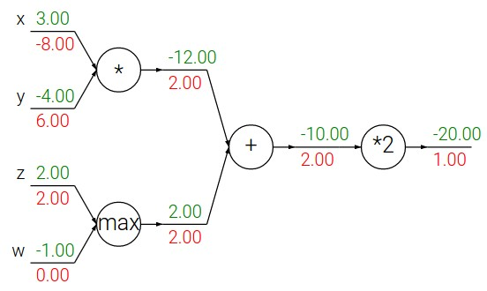
Patterns in backward flow
add gate: gradient distributor
max gate: gradient router
mul gate: gradient… “switcher”?

Slide 43
Gradients add at branches
+

Slide 44
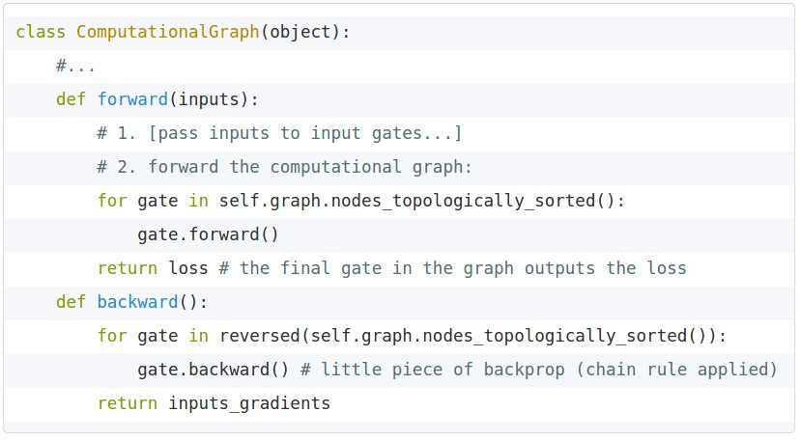
Implementation: forward/backward API
Graph (or Net) object. (Rough pseudo code)

Slide 45
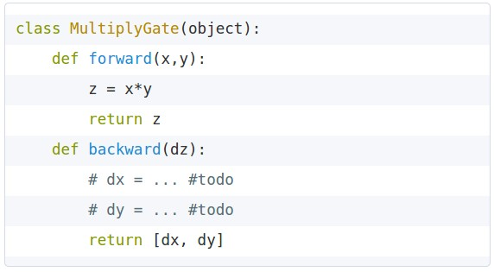
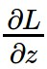
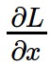
Implementation: forward/backward API
x
z
*
y
(x,y,z are scalars)

Slide 46
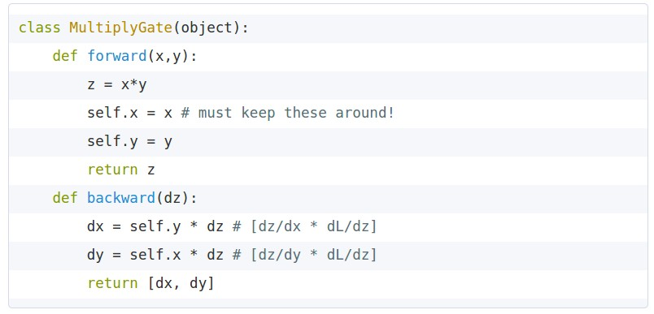

Implementation: forward/backward API
x
z
*
y
(x,y,z are scalars)

Slide 47
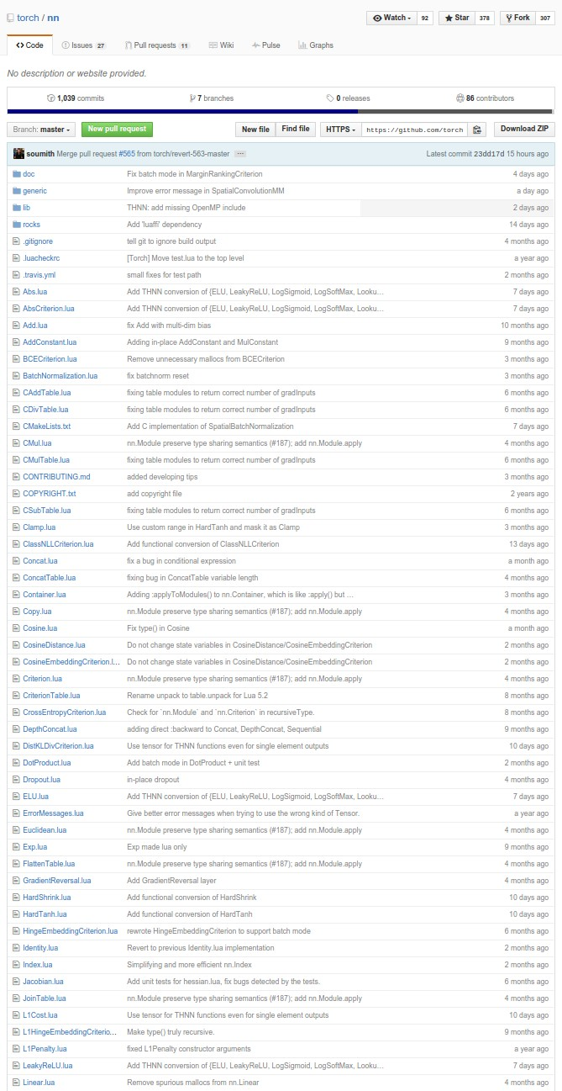
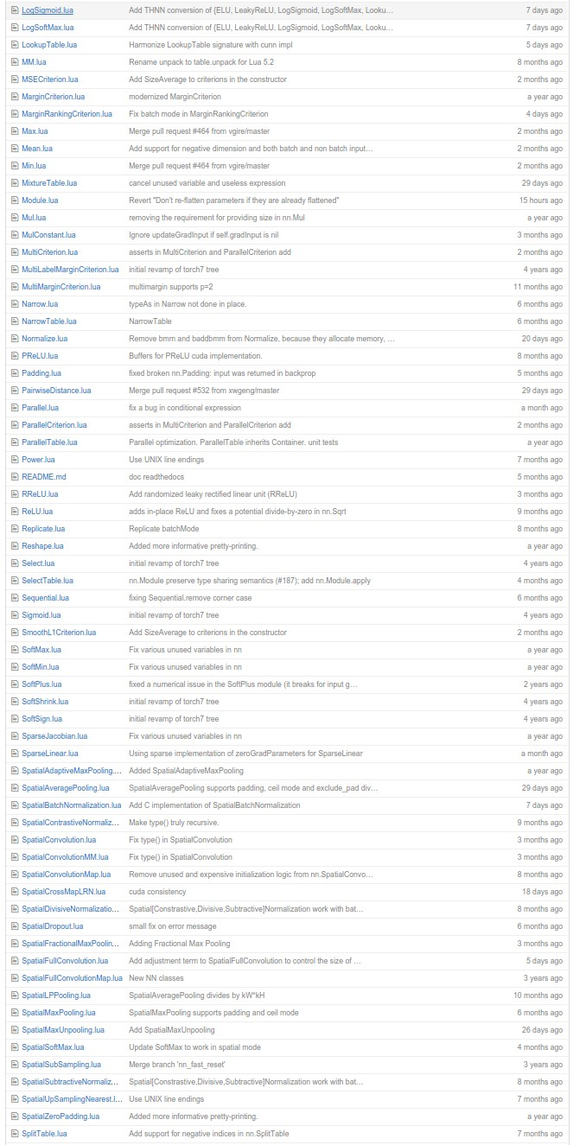
Example: Torch Layers

Slide 48
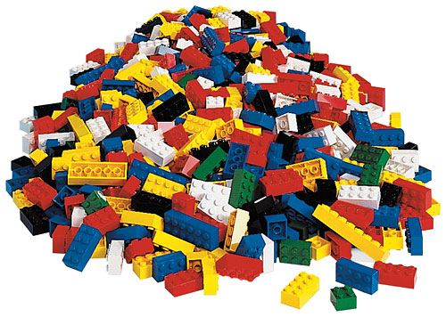
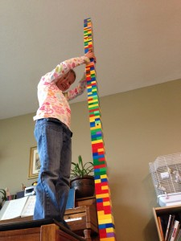

Example: Torch Layers
=

Slide 49
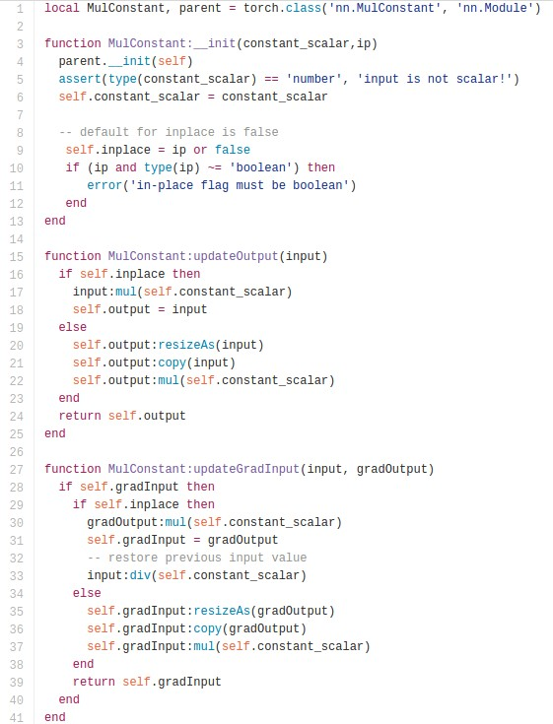
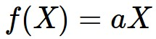
Example: Torch MulConstant
initialization
forward()
backward()

Slide 50
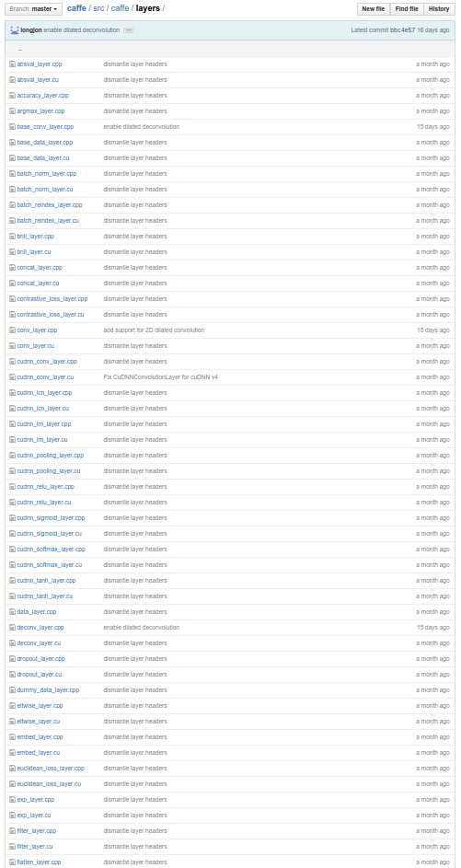
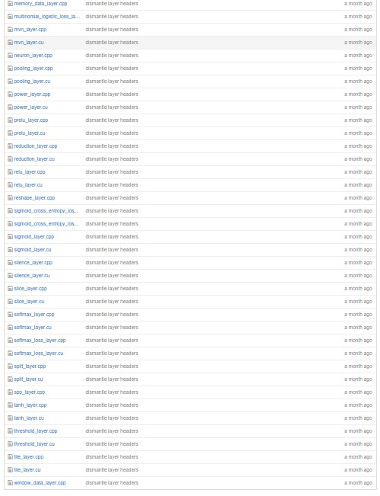
Example: Caffe Layers

Slide 51

Example: Caffe Layers
Lead developer of Caffe: Evan Shelhamer

Slide 52
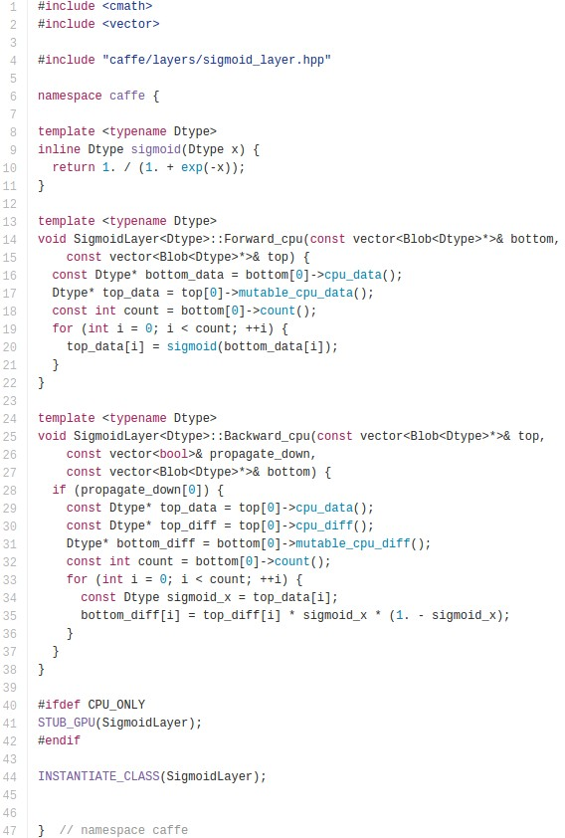
Caffe Sigmoid Layer
*top_diff (chain rule)

Slide 53
Gradients for vectorized code
(x,y,z are now vectors)
This is now the Jacobian matrix (derivative of each element of z w.r.t. each element of x)
f
“local gradient”
gradients

Slide 54
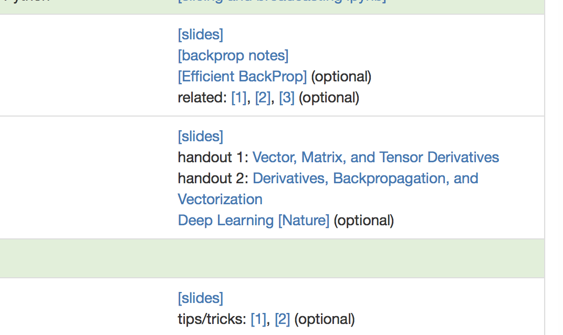

Slide 55
Vectorized operations
f(x) = max(0,x)
(elementwise)
4096-d
input vector
4096-d
output vector

Slide 56
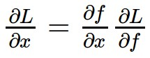
Vectorized operations
Jacobian matrix
f(x) = max(0,x)
(elementwise)
4096-d
input vector
4096-d
output vector
Q: what is the size of the Jacobian matrix?

Slide 57
Vectorized operations
Jacobian matrix
max(0,x)
(elementwise)
f(x) = max(0,x)
(elementwise)
4096-d
input vector
4096-d
output vector
Q: what is the size of the Jacobian matrix?
[4096 x 4096!]
Q2: what does it look like?

Slide 58
Vectorized operations
in practice we process an entire minibatch (e.g. 100) of examples at one time:
max(0,x)
(elementwise)
f(x) = max(0,x)
(elementwise)
100 4096-d
input vectors
100 4096-d
output vectors
i.e. Jacobian would technically be a
[409,600 x 409,600] matrix :\

Slide 59
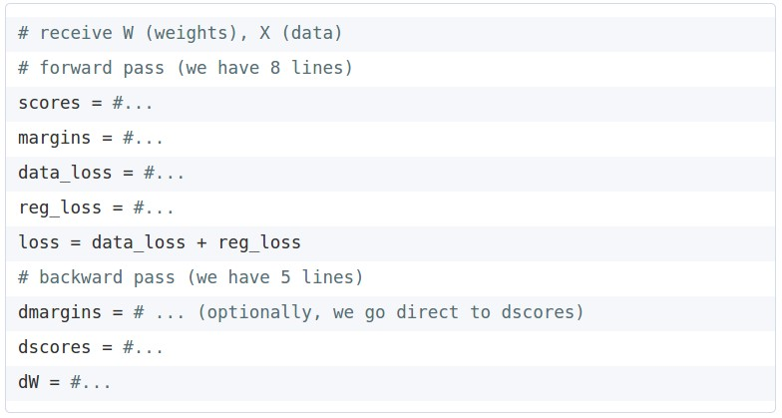
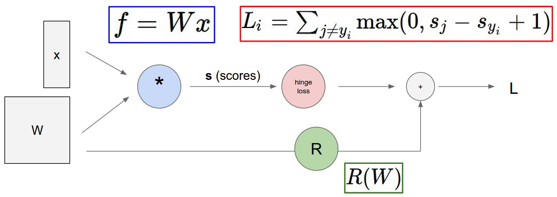
Assignment: Writing SVM/Softmax
Stage your forward/backward computation!
margins
E.g. for the SVM:

Slide 60
Summary so far
neural nets will be very large: no hope of writing down gradient formula by hand for all parameters
backpropagation = recursive application of the chain rule along a computational graph to compute the gradients of all inputs/parameters/intermediates
implementations maintain a graph structure, where the nodes implement the forward() / backward() API.
forward: compute result of an operation and save any intermediates needed for gradient computation in memory
backward: apply the chain rule to compute the gradient of the loss function with respect to the inputs.

